Slide 1
交換學生申請 (懶人包)
簡報製作：國際事務處
時間：2018.12.04
(*註：懶人包內容顯示為最新校內或合作學公布內容，供作參考之用)

Slide 2
交換生 特點
主要特性：
1.出國唸書(一般學分課程/實驗研修課程)，抵免母校學分
2.異國化交流，結交國際友人
3.提升語言能力
4.提升國際眼界
次要特性：
1.閒暇時間自助旅遊規劃
2.獨立自主，凡事靠自己解決難題

Slide 3
申請資格
於本校學士班及碩、博士班修業滿ㄧ學期，符合學生欲申請之交換校所設立條件。
出國研修期間須維持在學學生身分，不得辦理畢業或休學手續。
學業成績、外語能力門檻：依照海外研修機構之要求標準。

Slide 4
申請三步驟 快速搞懂~!
點選圖片超連結喔!
Step 1. 提出申請(校內甄選)
Step 1. 提出申請(校內甄選)
Step 2. 提出申請(校外決選)
Step 2. 提出申請(校外決選)
Step 3. 出國前後應繳資料

Slide 5
合作學校列表
網址：
https://oia.ntut.edu.tw/files/11-1019-9243.php?Lang=zh-tw

Slide 6
推薦的 合作學校
歐洲
每月平均生活費： 350 - 400歐元
國家 | 學校
奧地利 | Vorarlberg University of Applied Sciences
 | The MCI Management Center Innsbruck
 | University of Applied Sciences - Fachhochschule Kufstein FH Tirol
 | University of Applied Sciences for Management and Communication
 | Salzburg University of Applied Sciences

Slide 7
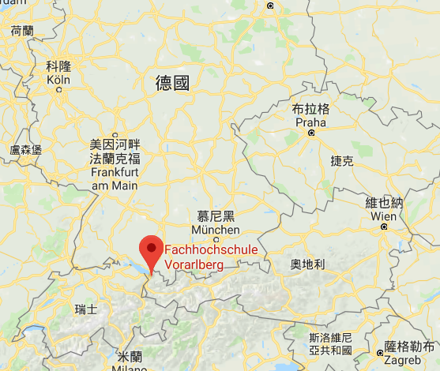
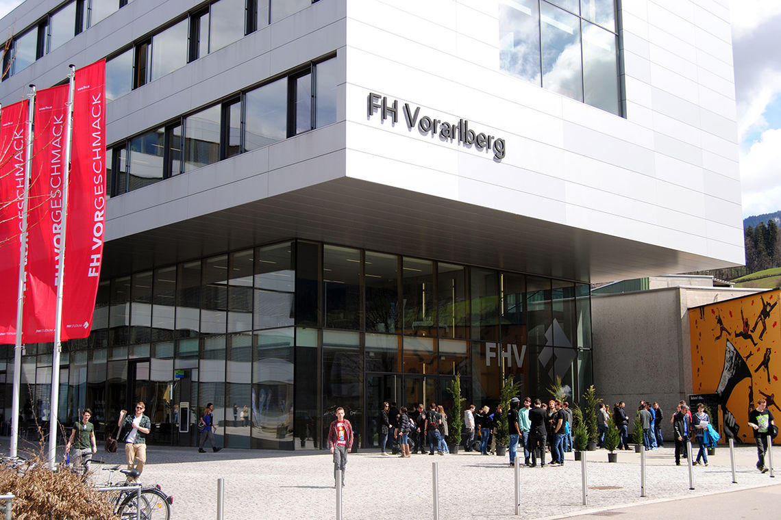
奧地利 Vorarlberg University of Applied Sciences
 Exchange Program: Students Exchange
Language Requirement: European CEFR English ( Level B2 )
Courses: Business, Engineering , Mechatronics,
Computer Science…etc.
 Accommodation: 332 - 400 EURO / Month

Slide 8
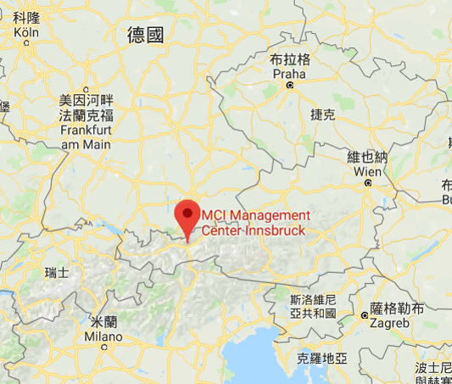
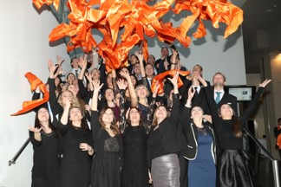
奧地利 The MCI Management Center Innsbruck
 Exchange Program: Exchange Incoming Students
Language Requirement: Be proficient in English
Courses: Business & Technology, Management , Marketing…etc.
 Accommodation: 295-325 EURO / Month

Slide 9
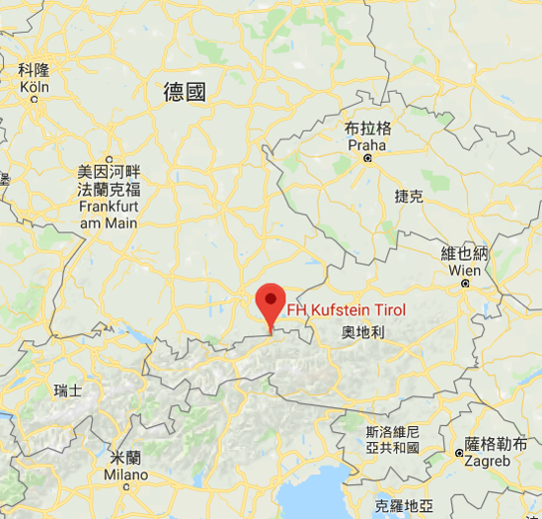
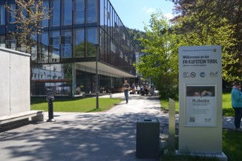
奧地利 University of Applied Sciences – Fachhochschule Kufstein FH Tirol
 Exchange Program: International Program
 Language Requirement: Be proficient in English/German
Courses: Business & Technology, Management, Marketing…etc.
(Taught in English or German)
 Accommodation: Average 300 EURO / Month

Slide 10
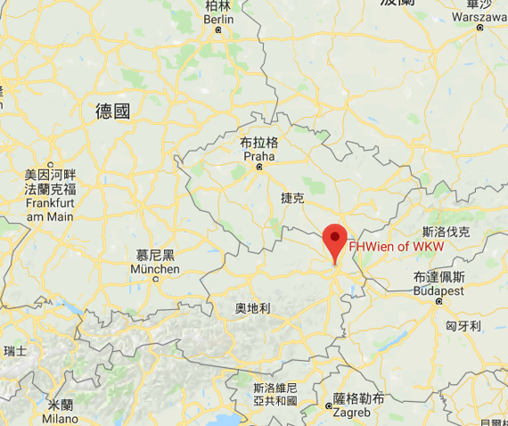
奧地利 University of Applied Sciences for Management and Communication
 Exchange Program: International Program
 Language Requirement: Be proficient in English
Courses: Culture, German Language, Business, Marketing…etc.
(Taught in English or German)
 Accommodation: Average 400 EURO / Month

Slide 11
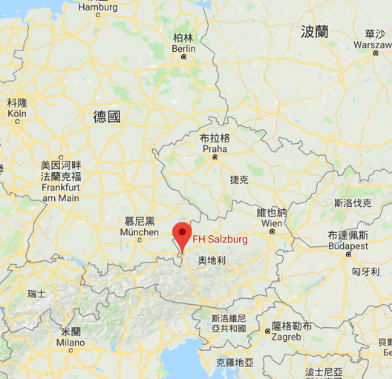
奧地利 Salzburg University of Applied Sciences
 Exchange Program: International Program
 Language Requirement: European CEFR English ( Level B2 )
Courses: MultiMedia Technology, Art, Business Management…etc.
(Taught in English or German)
 Accommodation: Average 300 EURO / Month

Slide 12
推薦的 合作學校
歐洲
每月平均生活費： 500 - 800歐元
國家 | 學校
法國 | Institut Polytechnique des Sciences Avancées (IPSA)
 | SIGMA Clermont
 | ESTIA

Slide 13
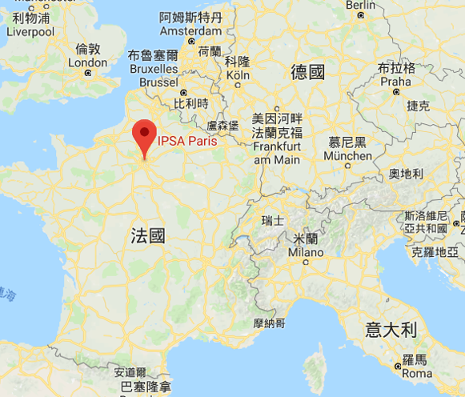
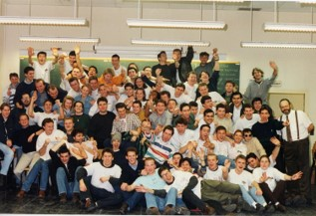
法國 Institut Polytechnique des Sciences Avancées (IPSA)
 Exchange Program: International Program
 Language Requirement: European CEFR English ( Level B2 )
Courses: Vehicle, Mechanics, Computer Science…etc.
(Taught mainly in English)
 Accommodation: Average 550 EURO / Month

Slide 14
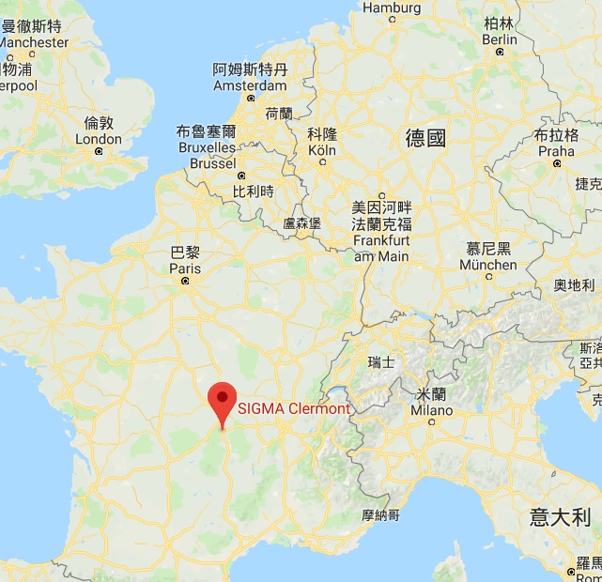
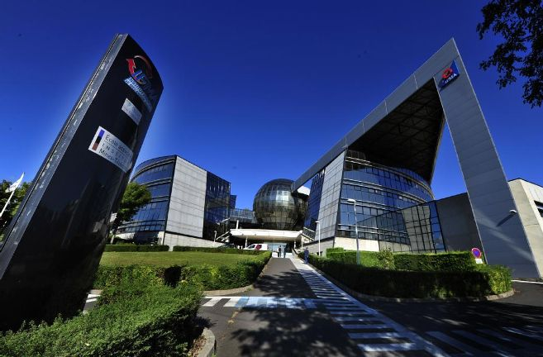
法國 SIGMA Clermont
 Exchange Program: International Admissions
 Language Requirement: European CEFR French ( Level B1 )
Courses: Chemistry, Mechanics…etc.
(Taught mainly in French; Research mainly in English)
 Accommodation: Average 550 EURO / Month

Slide 15
推薦的 合作學校
亞洲
每月平均生活費： 10,000 – 13,000台幣
國家 | 學校
俄羅斯 | Tomsk state university
 | Ural Federal University
土耳其 | METU (Middle East Technical University)

Slide 16
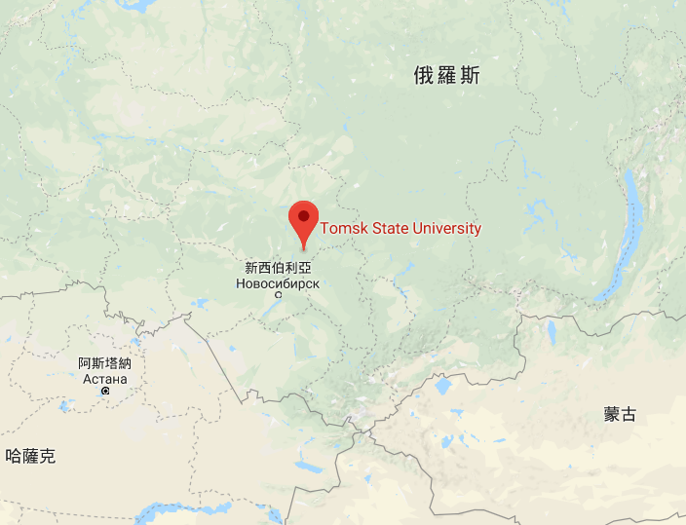
俄羅斯 Tomsk state university
 Exchange Program: Exchange Students
 Language Requirement: Intermediate Level English/Russian
Courses: Mechanics, Arts, Management, Computer Science…etc.
(Taught mainly in Russian and English)
 Accommodation: Average 400-500 TWD (850.91 Rubles)/ Month

Slide 17
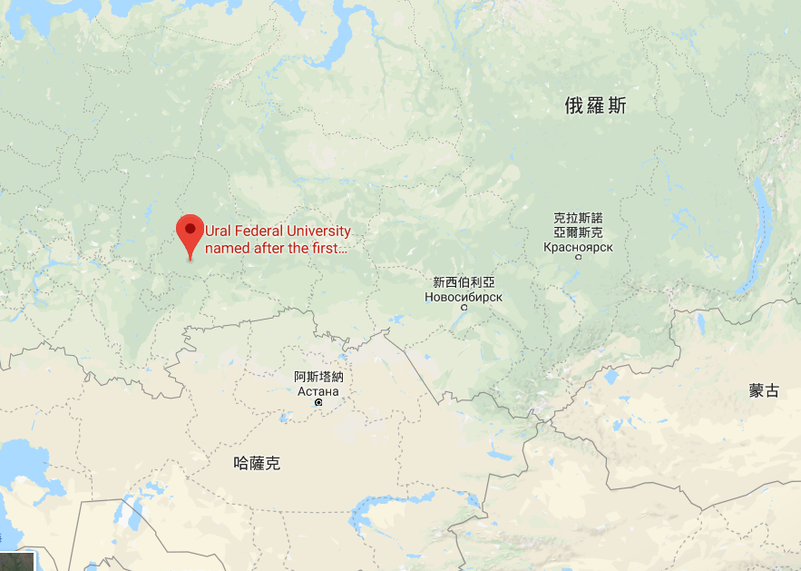
俄羅斯 Ural Federal University
 Exchange Program: UrFU International Profile
 Language Requirement: European CEFR English ( Level B1-B2 )
Courses: Social Sciences, Language, Psychology, Economics and
Business …etc. (Taught mainly in Russian and English)
 Accommodation: Average 450-550 TWD (1,000 Rubles)/ Month

Slide 18
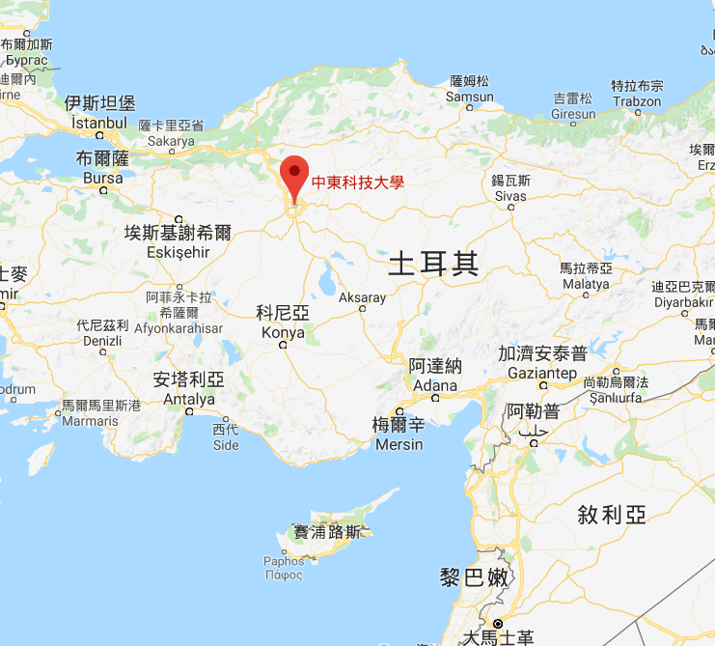
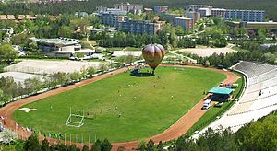
土耳其 METU (Middle East Technical University)
 Exchange Program: Overseas Exchange Program
 Language Requirement: European CEFR English ( Level B1)
Courses: Business, Architecture , Environment Engineering,
IT, Biology, Design…etc. (Taught mainly in English)
 Accommodation: Average 500-800 TWD (150YTL)/ Month

Slide 19
推薦的 合作學校
亞洲
每月平均生活費： 25,000台幣
國家 | 學校
韓國 | Dongguk University
 | Pukyong National University (PKNU)
 | Chungbuk National University

Slide 20
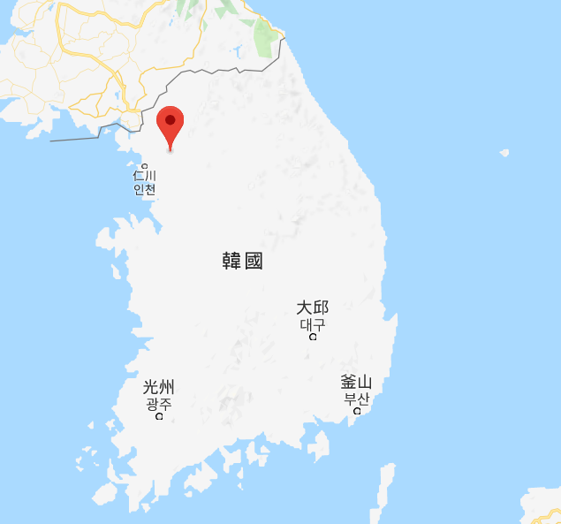
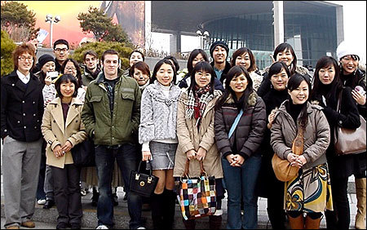
韓國 Dongguk University
 Exchange Program: Exchange Program
 Language Requirement: Basic English skills without proof
Courses: Engineering, Chemistry , Finance, IT, Biology, Art…etc.
(Taught in English 20%-30%; Mainly in Korean)
 Accommodation: Average 7,000 TWD (250,000 KRW)/ Month

Slide 21
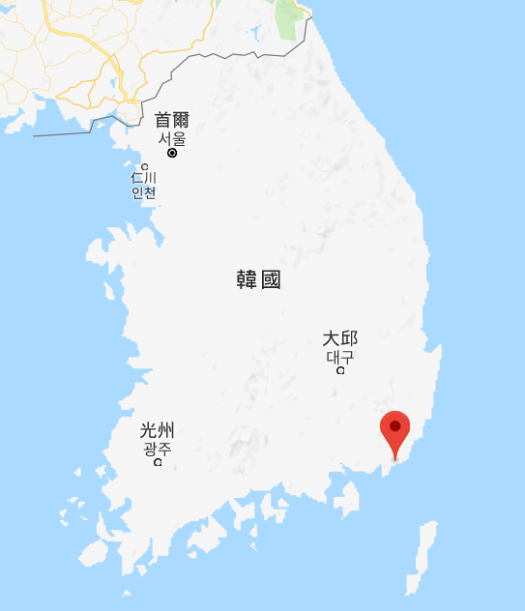
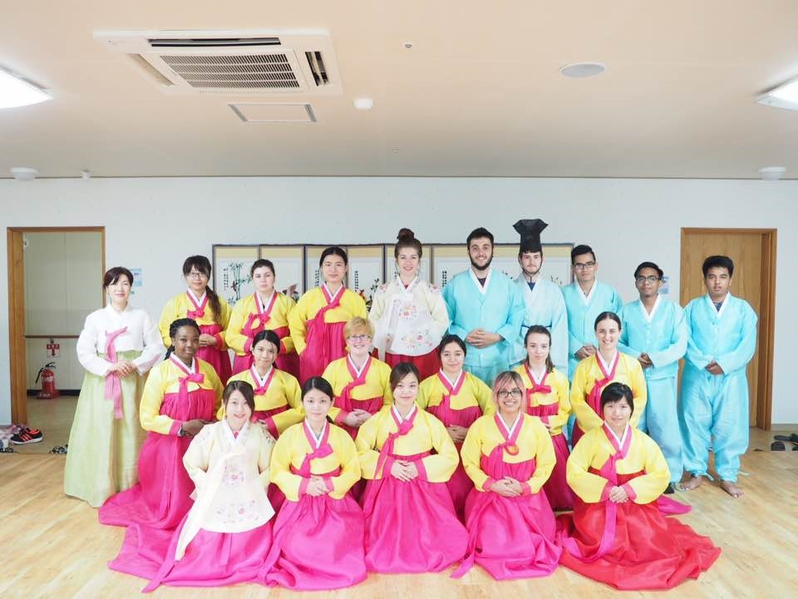
韓國 Pukyong National University (PKNU)
 Exchange Program: Exchange Program
 Language Requirement: Basic English skills without proof
Courses: :Language Programs, Business, Management…etc.
(Taught in English / Korean)
 Accommodation: Average 7,000 TWD (250,000 KRW)/ Month

Slide 22
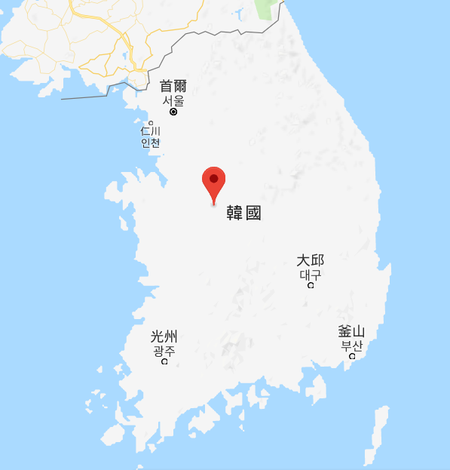
韓國 Chungbuk National University
Exchange Program: Exchange Student Program(CBNU ESP)
Language Requirement: Basic English/Korean skills without proof
Courses: :Engineering and Management Limited
(Taught in English / Korean)
 Accommodation: Average 4,700-5,500 TWD (210,000 KRW)/ Month

Slide 23
推薦的 合作學校
亞洲
每月平均生活費： 10,000 – 15,000台幣
國家 | 學校
泰國 | Chulalongkorn University
 | King Mongkut's University of Technology Thonburi (KMUTT)
 | King Mongkut's Institute of Technology Ladkrabang (KMITL)

Slide 24
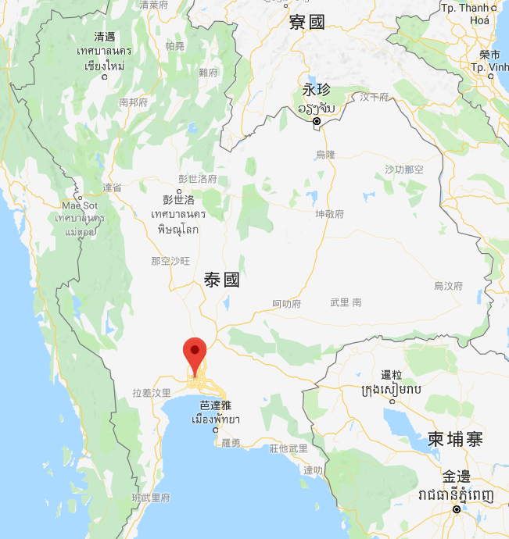
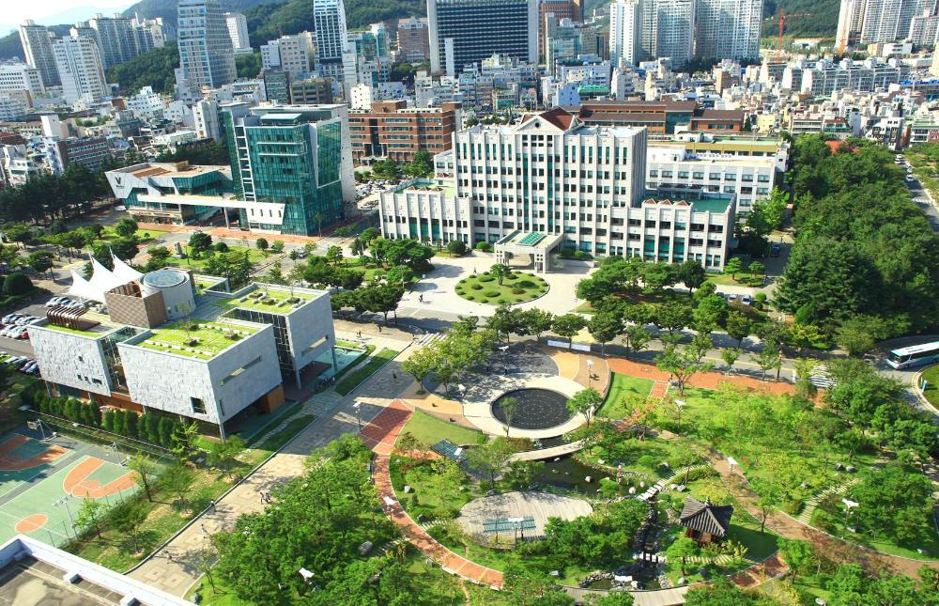
泰國 Chulalongkorn University
Exchange Program: Exchange Student Program(CBNU ESP)
Language Requirement: Be proficient in English
Courses: :Accounting, Commerce, Arts, Finance, Marketing…etc.
(Taught in English)
 Accommodation: Average 12,600 TWD (420 USD)/ Month

Slide 25
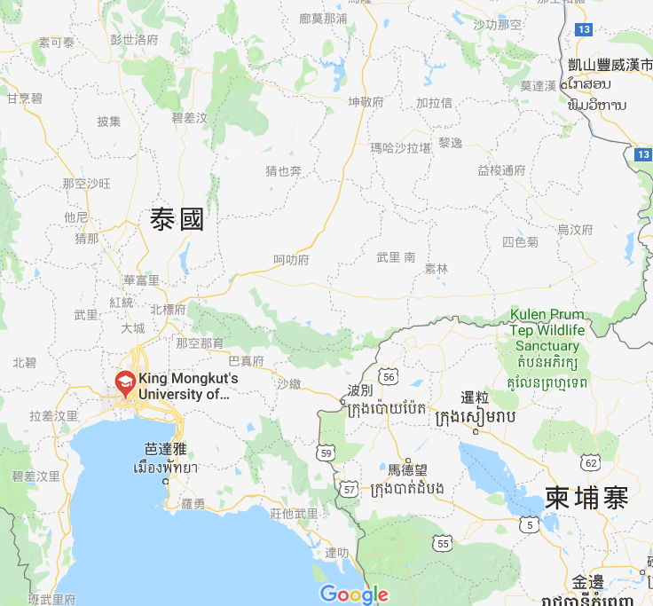
泰國 King Mongkut's University of Technology Thonburi (KMUTT)
Exchange Program: Exchange Student Program
Language Requirement: Be proficient in English
Courses: :Engineering, Architecture, IT, Energy & Environment…etc.
(Taught in English)
 Accommodation: Average 15,000 TWD (500 USD)/ Month

Slide 26
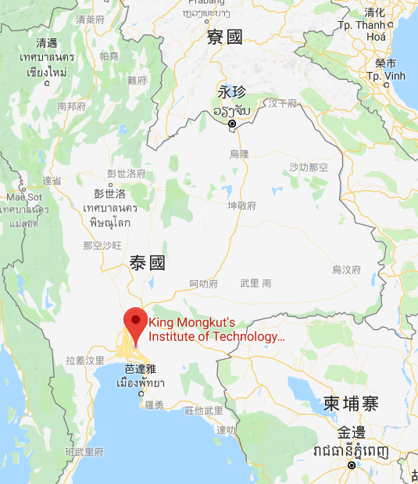
泰國 King Mongkut's Institute of Technology Ladkrabang (KMITL)
Exchange Program: Exchange Student Program
Language Requirement: Be proficient in English
Courses: : Courses in accordance with the school
(Taught in English)
 Accommodation: Average 15,000 TWD (500 USD)/ Month

